Slide 1
Welcome to Pennine Education Spring Term Briefing 10th Jan 2024
Welcome to the
Pennine Education Summer Term Briefing
Notes:
Welcome to Pennine Education's Summer Term Briefing for secondary schools.
Some of you may have already attended the previous briefings and you may have noticed that we have now use the format of remote sessions using Microsoft Teams. Ordinarily we would have the term briefings at Hollinwood Business Centre but due to lockdown restrictions through using Microsoft teams.
For those that are new to the briefings, welcome and to those that are new this term to have support with Pennine Education you are also welcome. I like to thank everyone for taking the time out to join us today.

Slide 2
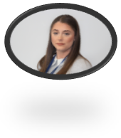
Introductions
Jonathan Howells – Pennine Education –
Rebecca Smith – Pennine Education -
Notes:
I’ll start with introducing Elaine for those that haven’t met or spoken to her yet. Elaine is one of the founding directors of Pennine Education and has an extensive background knowledge SIMS, Personnel, FMS, SIMS pay, Dinner Money and many more. She used to work as a SIMS and FMS consultant for Warrington Local Borough Capita then in 2014 launched Pennine Education Ltd.
I've been with Pennine Education since September 2017 as a SIMS support consultant. I had worked in a another SIMS support unit prior to that and have also worked as a data manager in a SIMS secondary school since 2009. So I am familiar with the day-to-day challenges you face as key administrative personnel within a school. So I have a background in timetabling, assessments, Census returns, data analysis, reporting, et cetera.

Slide 3
Agenda
AGENDA
Statutory Returns
School Census
CES Census
FMS Update
Pre Admissions
Contract Renewal
Summer Briefing
Helpdesk
Questions

Slide 4
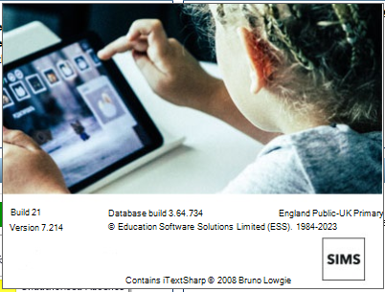
SIMS Version
Before you can start the Spring Statutory Returns you will need to have upgraded to the SIMS Autumn release Version 7.214
If you are not sure if SIMS has been upgraded - in SIMS Select Help | About SIMS.Net and the version information will be displayed

Slide 5
Data Item Updates
Data Item Updates

Slide 6
Updates - School Time
School Time is a new data item being collected in the Spring 2024 Census for the first time.
The definition of School Time is the total compulsory time pupils spend in school, in a typical five-day week, i.e. from morning registration to the end of the school day (official home time). This includes breaks and lunchtime but not optional activities before or after school Where a school is open for 32 and a half hours, for example, this is recorded as 32.50, with 32 and three-quarter hours being 32.75 NOT APPLICABLE TO NURSERY SCHOOLS

Slide 7
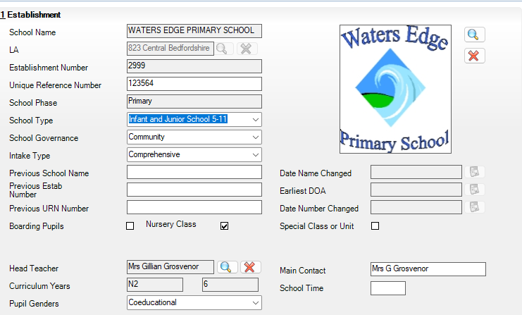
Updates - School Time
School Time is entered in via Focus \ School \ School Details \ Panel 1

Slide 8
Pennine Education
SCHOOL CENSUS 18TH JANUARY 2024
Notes:
Let’s take a look at the date ranges of data capture for the key areas

Slide 9
School Census
Collection Dates - Spring 2024
Notes:
Let’s take a look at the date ranges of data capture for the key areas

Slide 10
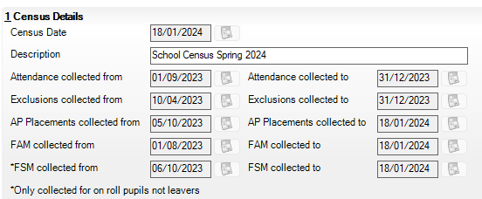
Census Reference Date
Collection Dates
The Census Reference Date is set to 18/01/2022
Notes:
As you can see, the Census date is next Thursday the 20th May. Although the Census is set for that date, you don’t necessarily have to authorise and upload it to COLLECT or the Local Authority for that date. They normally give you a few weeks to get that data submission ready.
Is it possible to create multiple returns but the Description or name needs to be unique.
So when you create the new return the description will default to the words school Census summer 2021. However, you can amend this if you choose to do so.

Slide 11
Attendance Data
Attendance is collected for the previous term for all Schools
Notes:
As you can see, the Attendance data is collected from 1st of January 2021 till the 4th April, i.e for the Spring Term.
Aim to make sure that there aren’t any missing marks on this date range. You can run the inbuilt Sims report to check for missing marks. Just enter the same date range as shown above when you and the reports and any missing marks will be highlighted.

Slide 12
Exclusions Data
Exclusions are collected for two Terms previous
Notes:
The next section on the overview is the exclusions date range. As you can see,
Exclusions are collected for the previous 2 terms, i.e. the Autumn and Spring Terms.

Slide 13
FSM Data
AP Data is collected from the last Census until the current Census
Notes:
For sixth form schools, the learner support data is collected for the previous two terms

Slide 14
FSM Data
FAM Data is collected from the beginning of the Academic Year Until Census week
Notes:
For sixth form schools, the learner support data is collected for the previous two terms

Slide 15
FSM Data
Free School Meals Data is collected from the day after the previous Census to Census day
Notes:
For sixth form schools, the learner support data is collected for the previous two terms

Slide 16
Spring Census Specific Data Items
Class Details at Selected Time
Childcare Information
FSM Taken
Early Years Pupil Premium Receipt & Basis for Funding, plus 2 Year old Basis for Funding
SEN Type and Ranking
Young Carer Indicator

Slide 17
Selected Time
In the January Census Schools are required to provide information on the classes running at a selected time and the class activity undertaken at that time
A schools selected time is based on the last digit of the schools DfE Establishment Number

Slide 18
Selected Time
Last Digit of School DfE Code | Selected Time
4, 7,8 or 9 | The selected time is one hour after the start of Morning school
0, 1 or 5 | The selected time is one hour before the end of morning school
2, 3 or 6 | The selected time is one hour after the end of afternoon school

Slide 19
Selected Time
When entering your Class data it is important that you check line by line that the correct information is showing, as well as adding any Support Staff where necessary and the Class Activity Where a Class Name is highlighted in Yellow you will need to provide a reason for exceeding the KS 1 Class size regulations

Slide 20
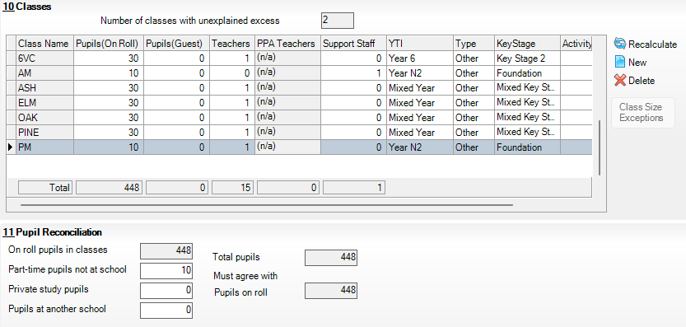
Selected Time
Remember!! If you have Nursery Pupils who are not in school at the selected time the class should be deleted, or numbers of the class reduced, and the corresponding number entered in the Part-time Pupils not at school field, in the Pupil Reconciliation panel

Slide 21
Infant Class Guidance
The School Admissions Regulations 2012 limit Infant (Reception and KS 1) class size during an “ordinary” Teaching session to 30 pupils per teacher.
Primary schools with Infant classes are asked to ensure that the selected period is one in which their infant classes are engaged in an “ordinary” teaching session.
An “ordinary” teaching session does not include school assembly or any other school activity usually conducted with large groups of children such as:- PE \ games \ music \ singing \ drama\ watching television \ listening to the radio

Slide 22
Infant Class Guidance
If, at the time of the count, infant class children would be involved in such a group activity, the count is deferred to the next “ordinary” teaching session.
This change of selected time is enacted for all classes in the school, not just the infant classes
Error 1235 – For key Stage 1 or Reception Classes class activity must reflect an “Academic Activity” will be generated if a non-academic activity is assigned to a Reception or Key Stage 1

Slide 23
Infant / Primary Admission Appeals
Information is required on the Number of Infant and Primary Appeals logged between March and August 2023 (inclusive) for entry to school in September 2023
Information on In Year appeals is not required
Remember Infant Appeals are a sub set of Primary appeals and schools should include their admission appeals figures for infants in both the Infants and Primary Admissions appeals module

Slide 24
Childcare Information
Childcare information should be checked and updated where necessary This can be found under Focus\School Details\Panel 6

Slide 25
DfE Validation Files
A minimum for Fileset 2604 must be used for Creation and Validation of the January Census and is available for download from the Pennine Education Website
We will advise if there are any later Filesets that need to be imported
Notes:
In the spring release of Sims, there is a base file set (1800) which has been included and is necessary when ever running the create and validate routine.
However, there may be known errors that need to be cleared so therefore ESS (previously capita) will work on producing a file set which will help clear some errors.

Slide 26
Resources
The latest Fileset is 2604 This is now available to download from our website:-
Pennine Education under the Documentation\Files tab
DfE Census Documentation DfE Guidance
Notes:
In the spring release of Sims, there is a base file set (1800) which has been included and is necessary when ever running the create and validate routine.
However, there may be known errors that need to be cleared so therefore ESS (previously capita) will work on producing a file set which will help clear some errors.

Slide 27
Dry Run
We would like to encourage all schools to complete a Dry Run as soon as possible, so that any Issues or Errors can be resolved in advance of the Census.
Fileset 2604 is available to download from our website with instructions on how to import into SIMS.
Census Notes will be available to download from our website from this afternoon
Password to download files from the website is: Springterm2024

Slide 28
Pennine Education
CATHOLIC EDUCATION SERVICE CENSUS
JANUARY 18th 2024
Notes:
Let’s take a look at the date ranges of data capture for the key areas

Slide 29
Pennine Education
New Intake 2024
Notes:
Let’s take a look at the date ranges of data capture for the key areas

Slide 30
Pennine Education
As soon as you are ready you can create you New Intake groups for your September Pre-Admissions Notes are available on the website for setting up and administering your Pre-Admission Groups
If your local Authority provides you with the ability to download your Pre-Admissions from SAM we would always advise that you import an ATF File rather that a CTF
If you need any help or advice, please log a call with the Helpdesk
Notes:
Let’s take a look at the date ranges of data capture for the key areas

Slide 31
Pennine Education
FMS Update
Notes:
Let’s take a look at the date ranges of data capture for the key areas

Slide 32
Pennine Education – Prem Plus
Prem Plus-
With Financial Year End coming up,
All discs will need to be run to close the year down in order to open up the new year.
If you don’t have these discs already, please contact your accountant and request these.
Notes:
We will now have a look at the SIMS software updates and any new features that have been introduced with the spring version 7.198

Slide 33
Pennine Education – Prem Plus
Any Questions on Prem Plus?
Notes:
We will now have a look at the SIMS software updates and any new features that have been introduced with the spring version 7.198

Slide 34
Pennine Education
Summer Briefings
Notes:
Let’s take a look at the date ranges of data capture for the key areas

Slide 35
Pennine Education
We will be holding the Summer Term Briefings Face to Face at the following locations:-
Oldham
Blackpool
Warrington
Cheshire East As soon as we have the confirmed dates we will let you know
Notes:
Let’s take a look at the date ranges of data capture for the key areas

Slide 36
Pennine Education
We will be doing a special session on SIMS Next Gen with colleagues from ESS and would like to encourage everyone to attend so that you are able to see a live demo of the latest developments in the SIMS Next Gen Software. If any other members of staff, such as your Head Teacher would like to attend, they will be more than welcome. As soon as we have the confirmed date for each location, we will let you know and send a full Agenda
Notes:
Let’s take a look at the date ranges of data capture for the key areas

Slide 37
Pennine Education
Contract Renewal
Notes:
We will now have a look at the SIMS software updates and any new features that have been introduced with the spring version 7.198

Slide 38
Pennine Education
Contract Renewal 2024 You should have received an email from John requesting your pupil numbers. If you have not done so, could you please return them to John as soon as possible @ jarmstrong@pennineeducation.co.uk
Contract Signing This year we have purchase electronic signature software, to make the contract signing easier. You will no longer need to print out, sign and then scan the document to return to us, you will be able to electronically sign the document, hopefully making the process more efficient for you.
Notes:
Let’s take a look at the date ranges of data capture for the key areas

Slide 39
Pennine Education
ESS Contract Renewal 2024 If anyone schools need help completing the ESS Contract renewal, through the ESS Portal, please let us know and we will be more than happy to help.
Notes:
Let’s take a look at the date ranges of data capture for the key areas

Slide 40
Pennine Education
Help Desk Performance
Notes:
We will now have a look at the SIMS software updates and any new features that have been introduced with the spring version 7.198

Slide 41
Performance Summary
Helpdesk Statistics from 01.9.2023 to 31.12.2023
No. of Calls Logged = 1785
No. of Calls Logged Resolved within SLA Agreement = 100%
No. of Calls Resolved on First Contact = 88%
We hope you are happy with the service you are receiving. If you have any comments, or you think anything can be improved upon please email : info@pennineeducation.co.uk.
Notes:
Here’s just a snapshot overview of our performance summary since January last year to March this year.
So we’ve had 876 tickets logged with a 100% service level agreement. The number of calls that resolved on first contact at 97.75%.
We always like to improve our service so if you think there’s anything that you think we could improve on or do better please do let us know. Or even if there’s just some general feedback you’d like to send us, you can do at the following email:
info@pennineducation.co.uk

Slide 42
Contact Information
Telephone
General Office/Helpdesk: 0161 509 2900
Email Addresses
support@pennineeducation.co.uk
info@pennineeducation.co.uk
Notes:
He is our general information.
So to get in touch with the help desk just our number (0161) 684 2320.
To log a ticket you can email support@pennineeducation.co.uk
And if a general enquiry you can email info@pennineducation.co.uk

Slide 43
Customer Satisfaction Survey
Thank you to everyone who completed the Customer Satisfaction Survey at the end of last month. We will publish the results before Half Term
Notes:
He is our general information.
So to get in touch with the help desk just our number (0161) 684 2320.
To log a ticket you can email support@pennineeducation.co.uk
And if a general enquiry you can email info@pennineducation.co.uk

Slide 44
Pennine Education
Any Questions?
Notes:
We will now have a look at the SIMS software updates and any new features that have been introduced with the spring version 7.198

Slide 45
Thank you for your time Any Questions?
Notes:
I’d like to say a huge thank you for you taking your time out today to be with us. If you have any questions you can ask them now or you can actually type them and we can then just chase those up for you at a later time.
I will stop recording shortly and I will send an email out that will give you a hyperlink to the webinar recording.
Thank you.

